Slide 1
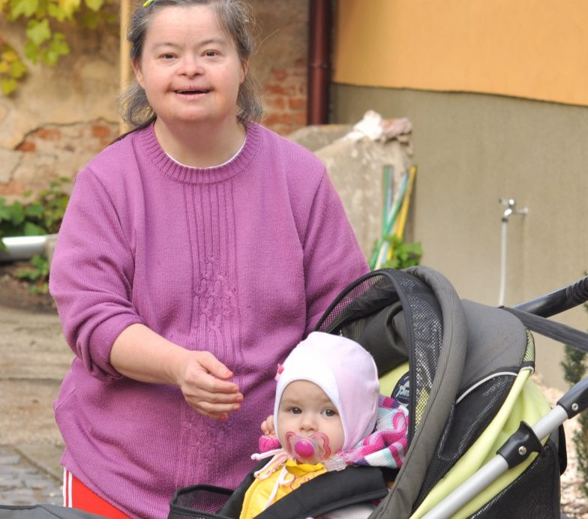
Mission Statement:
“We are Dedicated to Enhancing the Lives of Parents Living with Cognitive Difficulties and Their Families through Education, Advocacy, and Support.”
*Cognitive difficulties may include difficulties in learning, remembering, and making decisions that affect everyday life
TASP
1.(800).599.8810 info@achancetoparent.net
TASP
The Association for Successful Parenting
www.achancetoparent.net
Follow us on Facebook:
TheAssociationForSuccessfulParenting
Enhancing the Lives of Families When Parents Have Learning Difficulties

Slide 2
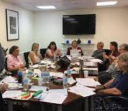
Education
Membership
Connections
TASP offers a variety of webinars and workshops that you can bring to your community. Visit our website to learn more about these opportunities.
Support TASP through a paid membership
TASP offers education, technical assistance, research information and access to an international group of providers, scholars and advocates with expertise in supporting parents with learning difficulties.
Benefits
● Receive our quarterly newsletter
● Support our national conference
● Access our educational initiatives
● Access technical assistance
● Support advocacy work
● Learn about our Peer Navigator Project - Successful Parenting DC through our website at: www.achancetoparent.net
We know that: Family life is complex. All families need support and rely on networks. Separation from parents is in the best interest of children only when reasonable efforts and appropriate services cannot ensure a child’s safety and health.
We believe that: Termination of the parental relationship should not be based upon a parent’s disability alone.
Parents need and deserve individualized assessment of adequate parenting skills and a chance to parent.

